Slide 1
File-System Interface

Slide 2
File-System Interface
File Concept
Access Methods
Directory Structure
File-System Mounting
File Sharing
Protection

Slide 3
Objectives
To explain the function of file systems
To describe the interfaces to file systems
To discuss file-system design tradeoffs, including access methods, file sharing, file locking, and directory structures
To explore file-system protection

Slide 4
File Concept
Types:
  Data
    numeric
    character
    binary
  Program

Slide 5
File Attributes
Name – only information kept in human-readable form
Identifier – unique tag (number) identifies file within file system
Type – needed for systems that support different types
Location – pointer to file location on device
Size – current file size
Protection – controls who can do reading, writing, executing
Time, date, and user identification – data for protection, security, and usage monitoring
Information about files are kept in the directory structure, which is maintained on the disk

Slide 6
File Operations
File is an abstract data type: a data type specifies logical properties without the implementation details
Create
Write
Read
Reposition within file
Delete
Truncate
Open(F_{i}) – search the directory structure on disk for entry F_{i}, and move the content of entry to memory
Close (F_{i}) – move the content of entry F_{i} in memory to directory structure on disk

Slide 7
Open Files
Several pieces of data are needed to manage open files:
  File pointer: pointer to last read/write location, per process that has the file open
  File-open count: counter of number of times a file is open – to allow removal of data from open-file table when last processes closes it
  Disk location of the file: cache of data access information
  Access rights: per-process access mode information

Slide 8
Open File Locking
Provided by some operating systems and file systems
Mediates access to a file
Mandatory or advisory:
  Mandatory – access is denied depending on locks held and requested
  Advisory – processes can find status of locks and decide what to do

Slide 9

File Types – Name, Extension

Slide 10
Access Methods
Sequential Access : The simplest access method is sequential access method. Information in the file is processed in order ,one record after the other
example : editors and compilers usually access files in this fashion
read next
write next
reset
no read after last write
(rewrite)
Direct Access (or) relative access : A file is made up of fixed length logical records that allows programs to read and write rapidly in no particular order
read n
write n
position to n
read next
write next
rewrite n
n = relative block number

Slide 11

Sequential-access File

Slide 12
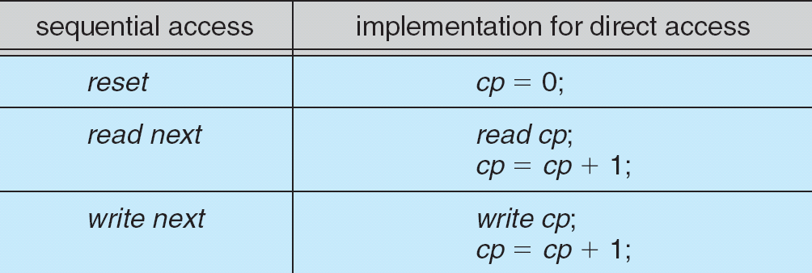
Simulation of Sequential Access on a Direct-access File

Slide 13

Example of Index and Relative Files

Slide 14
Directory Structure
A collection of nodes containing information about all files
Directory
Files
F 1
F 2
F 3
F 4
F n
Both the directory structure and the files reside on disk
Backups of these two structures are kept on tapes

Slide 15

A Typical File-system Organization

Slide 16
Operations Performed on Directory
Search for a file
Create a file
Delete a file
List a directory
Rename a file
Traverse the file system

Slide 17
Directory structures

Slide 18

Single-Level Directory
A single directory for all users
Naming problem
Grouping problem

Slide 19

Two-Level Directory
Separate directory for each user
Path name
Can have the same file name for different user
Efficient searching
No grouping capability

Slide 20

Tree-Structured Directories

Slide 21
Tree-Structured Directories (Cont)
Efficient searching
Grouping Capability
Current directory (working directory)
  cd /spell/mail/prog
  type list

Slide 22
Tree-Structured Directories (Cont)
Absolute or relative path name
Creating a new file is done in current directory
Delete a file
rm <file-name>
Creating a new subdirectory is done in current directory
  mkdir <dir-name>
Example: if in current directory /mail
mkdir count
mail
prog
copy
prt
exp
count
Deleting “mail” ⇒ deleting the entire subtree rooted by “mail”

Slide 23

Acyclic-Graph Directories
Have shared subdirectories and files

Slide 24
File System Mounting
A file system must be mounted before it can be accessed
A unmounted file system is mounted at a mount point

Slide 25
File Sharing
Sharing of files on multi-user systems is desirable
Sharing may be done through a protection scheme
On distributed systems, files may be shared across a network
Network File System (NFS) is a common distributed file-sharing method

Slide 26
File Sharing – Multiple Users
User IDs identify users, allowing permissions and protections to be per-user
Group IDs allow users to be in groups, permitting group access rights

Slide 27
File Sharing – Remote File Systems
Uses networking to allow file system access between systems
  Manually via programs like FTP
  Automatically, seamlessly using distributed file systems
  Semi automatically via the world wide web
Client-server model allows clients to mount remote file systems from servers
  Server can serve multiple clients
  Client and user-on-client identification is insecure or complicated
  NFS is standard UNIX client-server file sharing protocol
  CIFS is standard Windows protocol
  Standard operating system file calls are translated into remote calls
Distributed Information Systems (distributed naming services) such as LDAP, DNS, NIS, Active Directory implement unified access to information needed for remote computing

Slide 28
File Sharing – Failure Modes
Remote file systems add new failure modes, due to network failure, server failure
Recovery from failure can involve state information about status of each remote request
Stateless protocols such as NFS include all information in each request, allowing easy recovery but less security

Slide 29
Protection
File owner/creator should be able to control:
  what can be done
  by whom
Types of access
  Read
  Write
  Execute
  Append
  Delete
  List

Slide 30
Access Lists and Groups
Mode of access: read, write, execute
Three classes of users
RWX
a) owner access 7 ⇒ 1 1 1
RWX
b) group access 6 ⇒ 1 1 0
RWX
c) public access 1 ⇒ 0 0 1
Ask manager to create a group (unique name), say G, and add some users to the group.
For a particular file (say game) or subdirectory, define an appropriate access.
owner
group
public
chmod
761
game
Attach a group to a file
chgrp G game

Slide 31

Windows XP Access-control List Management

Slide 32

A Sample UNIX Directory Listing

Slide 33
End of Chapter

